Slide 1
Chap. 5
Applications of Newton’s Laws

Slide 2
Force

Slide 3
Force
Normal Force
L+ΔL
Spring Force
Frictional Force
Gravity
Tension
Gravity

Slide 4
T₁=T₂ =T
m₂g>T
m₁g<T
N
a
N=m₁g
T₁
T₂
T₁
T<m₂g
a
T₂
m₁g
a
m₁g
m₂g
T₁=T₂=T
a
m₂g

Slide 5
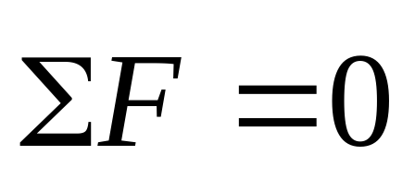
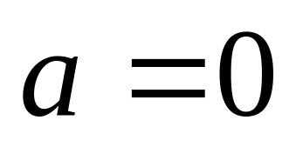
N
Normal Force
T
mg

Slide 6
G = mg
x
0
x
G
F = - kx
N
frictional force
Kinetic friction
f_{k} = μ_{k}N
Static friction
f_{s} = - ΣF_{ext}
≤ μ_{s}N
μ_{k} < μ_{s}

Slide 7
v=0
F
f _{s}= -F
f_{s}

Slide 8
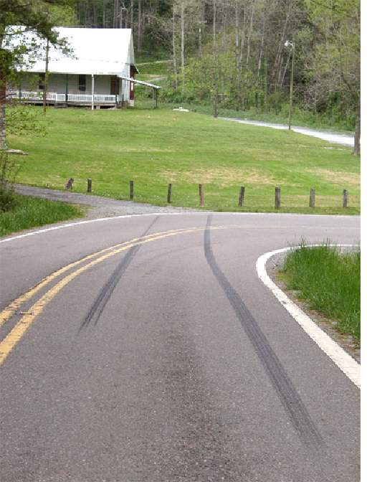
v=0
F
With ABS, the wheel rotates without slipping
f _{s}= -F
≤ μ_{s}N
With ABS, the car stop in shorter distance
f_{s}
v
F
f _{k}< f _{s}
f_{k}
f

Slide 9
The direction of frictional force?
v
F
f_{s}
f_{k}

Slide 10

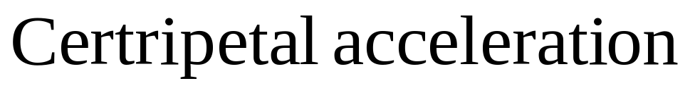
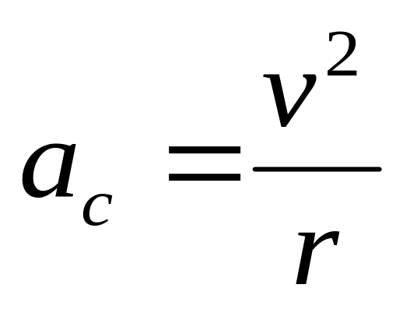
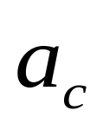

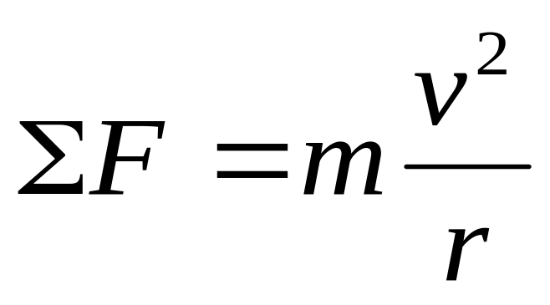
The Dynamics of Uniform Circular Motion

Slide 11
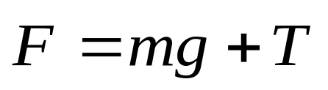
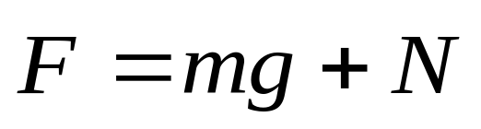

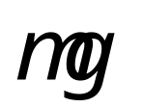

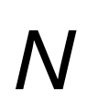
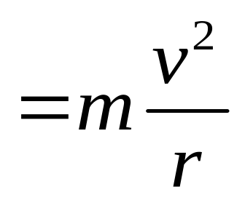
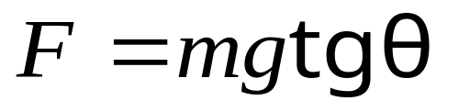
pendulum
Bancked curve
N
θ
F
T
θ
mg
F
mg

Slide 12
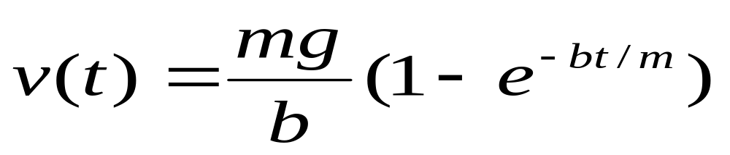
force depending on the velocity.
Position dependent forces
D
Time dependent forces
v(t)
When t→∞, v(t) →v_{T}=mg/b, this is the terminal speed.
mg
t
D = bv

Slide 13
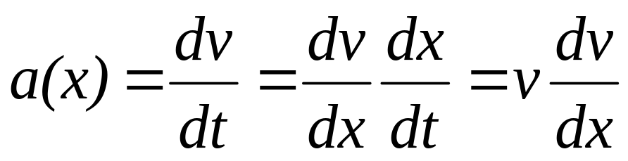
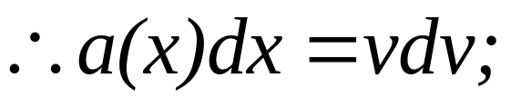
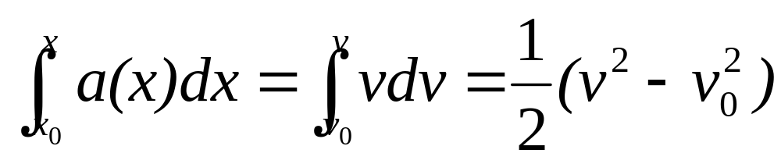
Force dependent on the position
F=F(r). Thus a is equal a(r).
For one dimension, a=a(x)

Slide 14
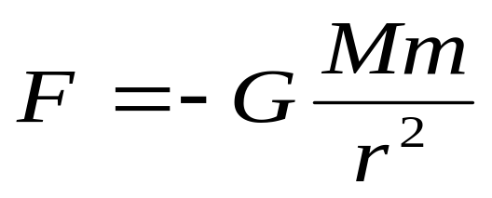

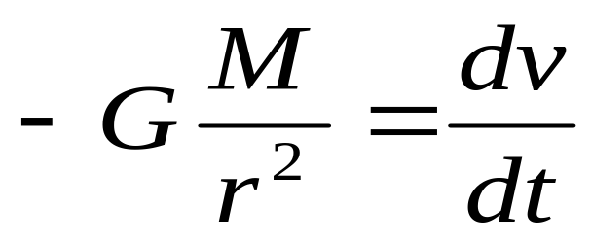
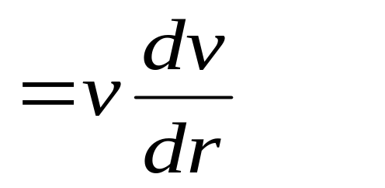
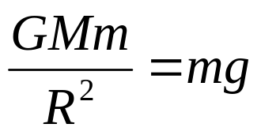
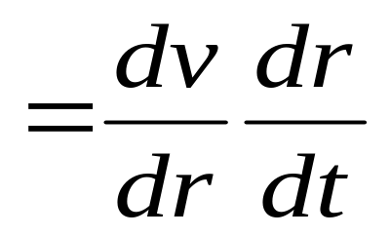
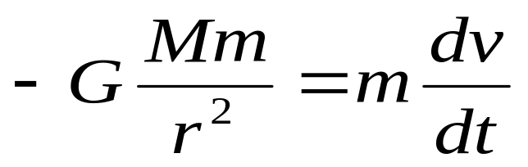
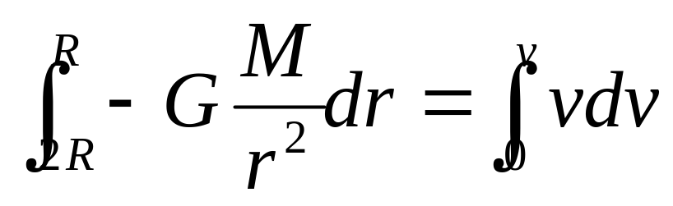
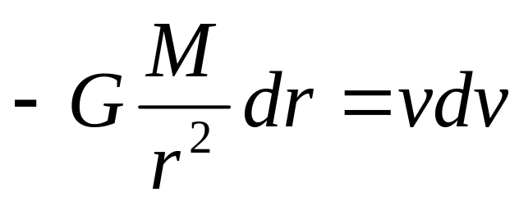
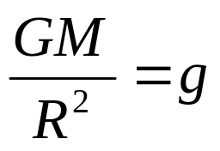
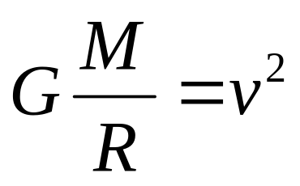
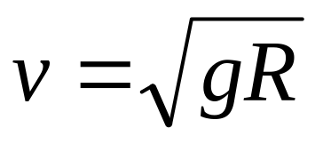
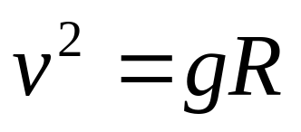
Example
An object, it is 2R from the center of the earth, is falling from rest vertically. R is the radius of the earth. Find the speed when the body arrived the earth’s surface. The drag force and the spin of the earth are not considered.
v
2R
R

Slide 15
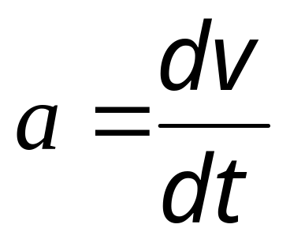
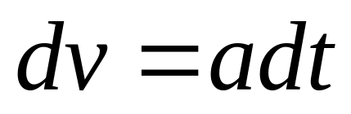
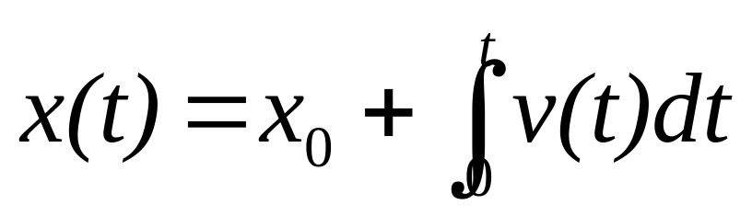
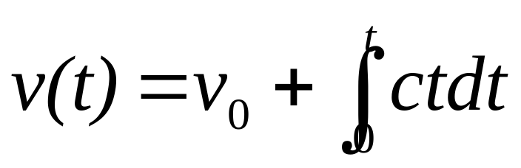
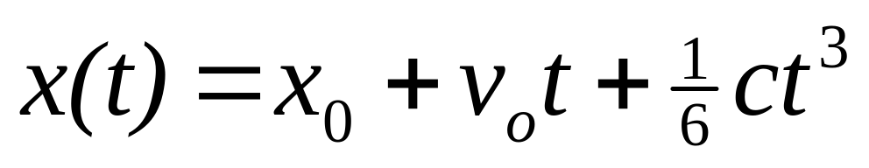
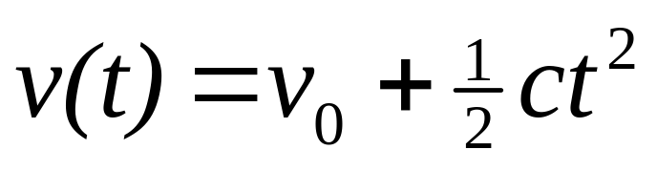
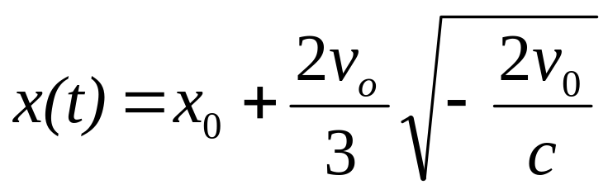
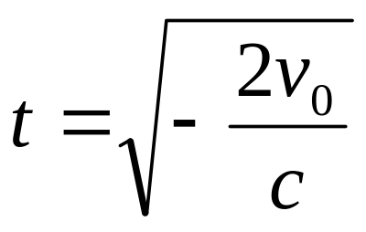
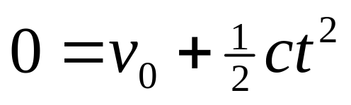
Time dependent forces
Example: A moving car alone x axis with velocity v₀, if a(t)= ct, How much time passes when the car is rest? How far does the car in travel when it rest?
F=F(t). Thus a is equal a(t)
v_{o}
F
a(t)=ct, c<0
x
x₀

Slide 16
Limitations of Newton’s lows
The speed of motion << c
Inertia frame
its velocity is constant relative to one another
If frame s’ moves with acceleration, it is not an inertial frames.
Noninertial frames and pseudoforces
How can we do?

Slide 17
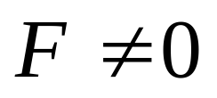
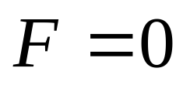
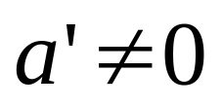
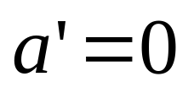
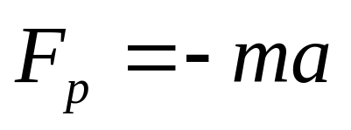
Noninertial frames and pseudoforces
a’
F_{p}
a
F_{p}
F
a
In both cases,
F≠ma′Newton’s low are violated.
inertial force
Pseudoforce

Slide 18
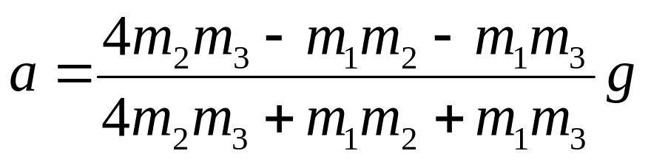
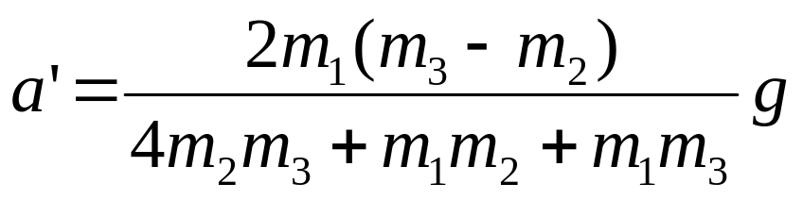
If m₁< m₂ +m₃ and m₂< m₃
T₁
a
Noninertial Frame
T₁ - m₁g= m₁ a
Pseudoforce, (-ma)
T₁=2 T₂
m₁
T₂
T₂
T₂ + m₂a – m₂g= m₂ a’
a
m₂a
m₃a
m₃g – m₃a - T₂ = m₃ a’
m₁g
a’
m₂
m₃
a=?
a’
m₂g
m₃g

Slide 19

What is the frame?
Noninertial frames with rotation
Why?
a=v²/r
F=mv²/r

Slide 20
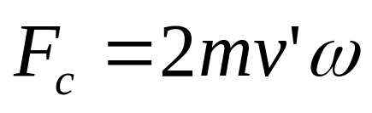
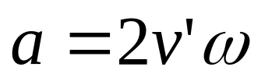
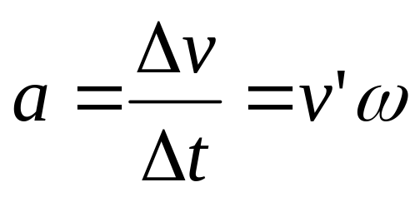
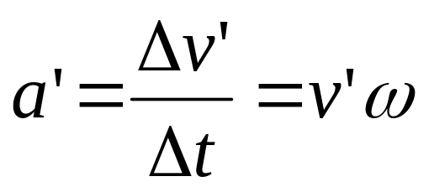
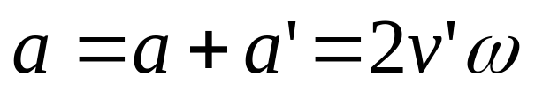
What is the frame?
Noninertial frames with rotation
Why?
Δv = rω - r’ω
r’
r
v’
=(r –r’)ω
Coriolis force
v’
=v’ Δt ω
a
Δv’
Δv’ = v’ Δθ
v’
Δθ
Δv’ = v’ Δt ω

Slide 21








What is the frame?
Noninertial frames with rotation
v’
Coriolis force
F=mv²/r

Slide 22


ω
v

Slide 23
ω
v
v

Slide 24
Chap. 4
Exercises
11 (P110 ), 18 (P111), 39 (P113)
Problems
17, 18 (P116)

